Slide 1

Setting up your goal
Size of dev
and test sets
deeplearning.ai

Slide 2
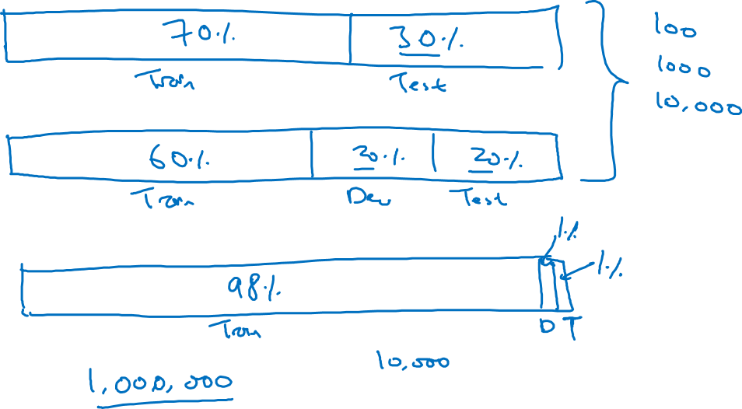
Old way of splitting data

Slide 3
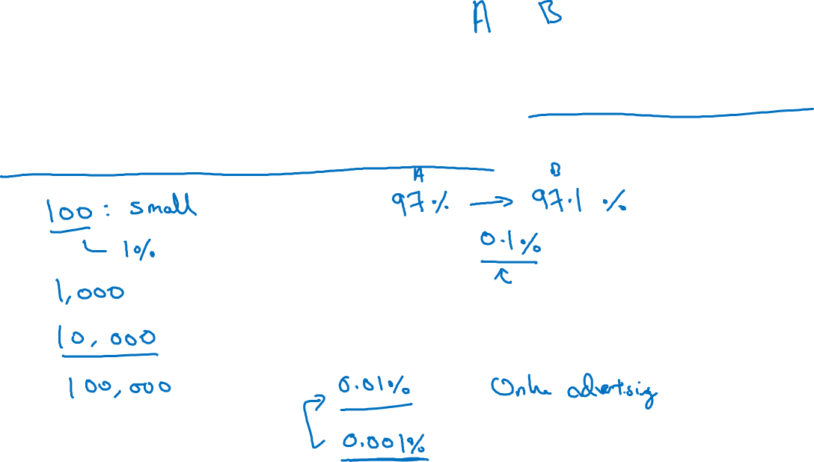
Size of dev set
Set your dev set to be big enough to detect differences in
algorithm/models you’re trying out.

Slide 4
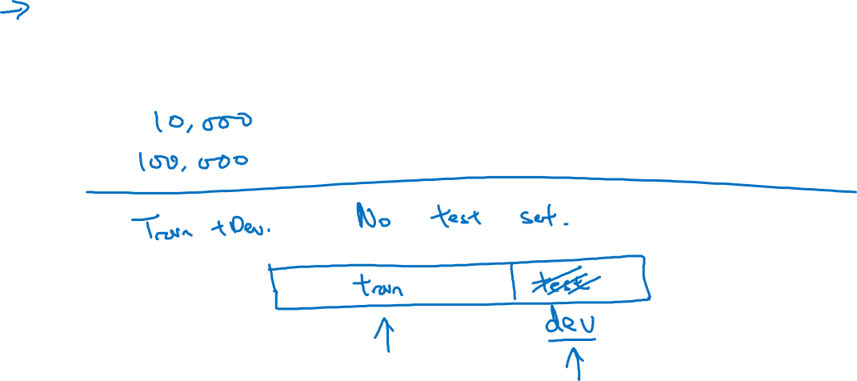
Size of test set
Set your test set to be big enough to give high confidence
in the overall performance of your system.

